Slide 1
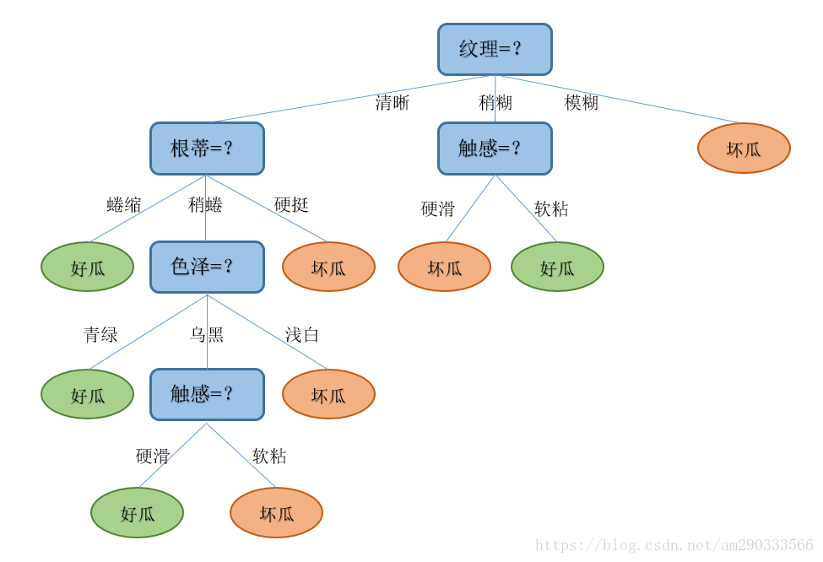
Decision Tree

Slide 2
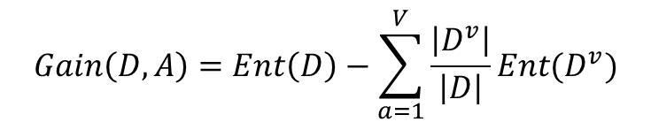
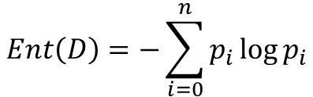
Decision Tree
ID3
信息熵
$$Ent\left(D\right)=−\sum_{i=0}^{n}{p_{i}\log{p_{i}}}$$
信息增益
$$Gain\left(D,A\right)=Ent\left(D\right)−\sum_{a=1}^{V}{\frac{\left|D^{v}\right|}{\left|D\right|}Ent(D^{v})}$$

Slide 3

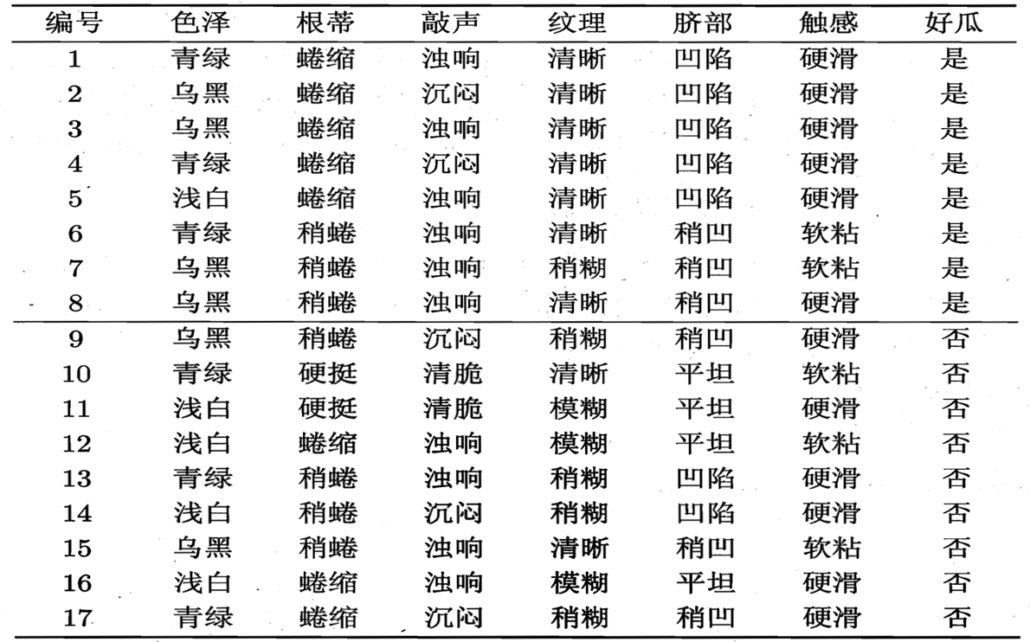
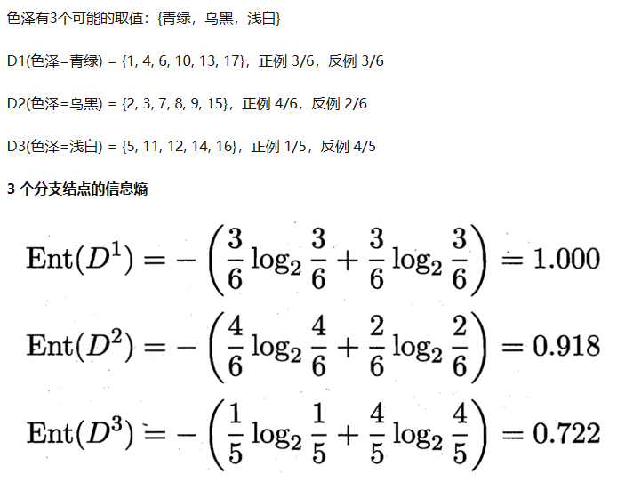
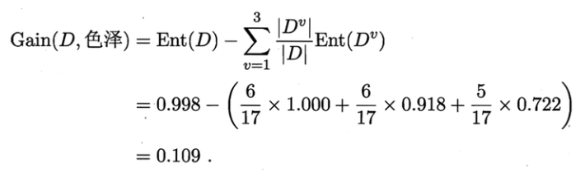
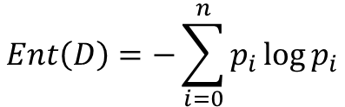
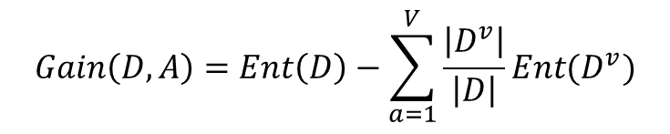
数据集信息熵:
Decision Tree
ID3
按特征划分的子集信息熵:
$$Ent\left(D\right)=−\sum_{i=0}^{n}{p_{i}\log{p_{i}}}$$
信息增益:
$$Gain\left(D,A\right)=Ent\left(D\right)−\sum_{a=1}^{V}{\frac{\left|D^{v}\right|}{\left|D\right|}Ent(D^{v})}$$

Slide 4
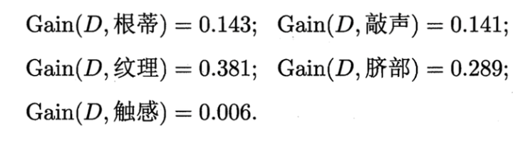
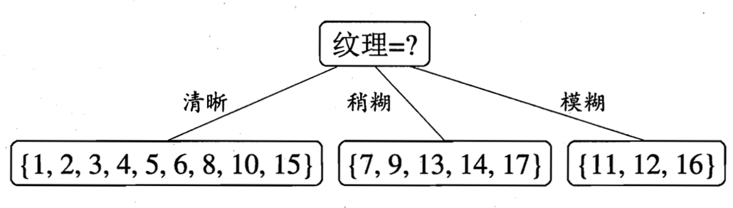
Decision Tree
ID3

Slide 5
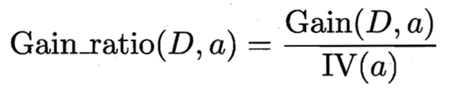
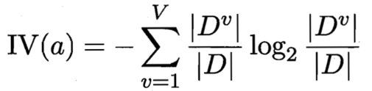
Decision Tree
C4.5
ID3的缺点：ID3算法倾向于选择子类别多的特征，易导致过拟合
信息增益率

Slide 6
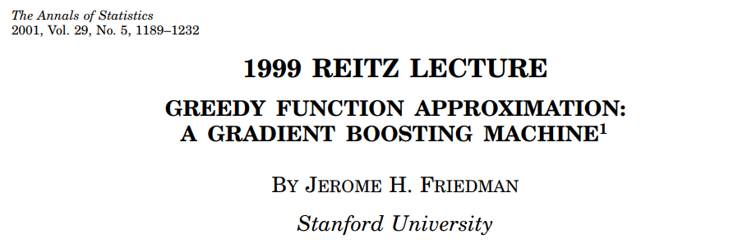
Gradient Descent Boosting

Slide 7
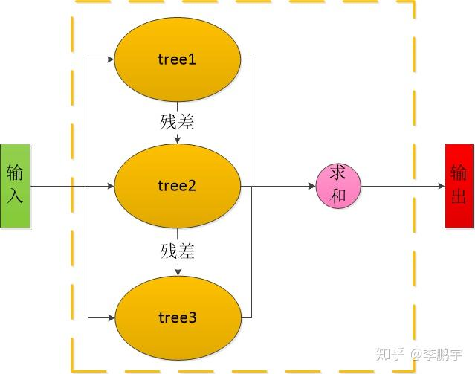

Gradient Descent Boosting
Boosting tree

Slide 8
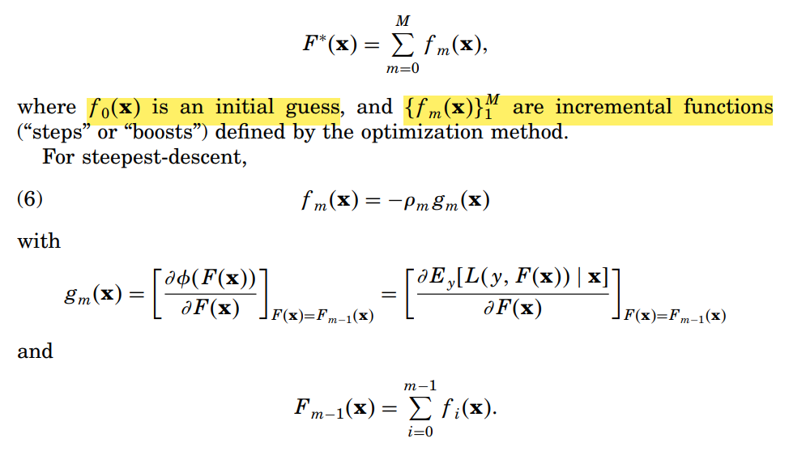
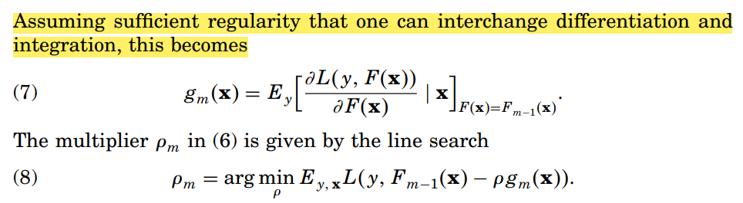
Gradient Descent Boostin

Slide 9
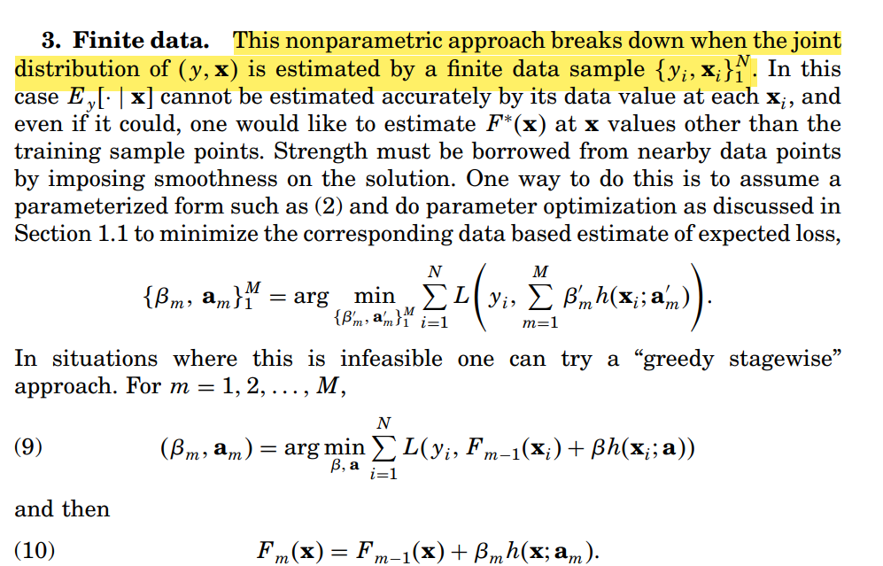
Gradient Descent Boosting

Slide 10
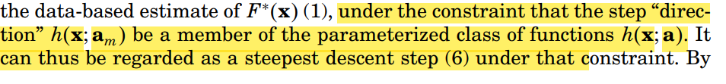
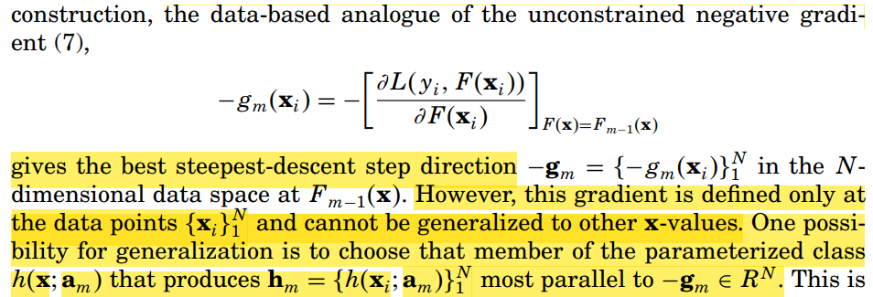
Gradient Descent Boosting

Slide 11
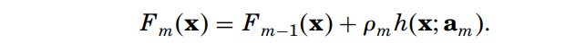
Gradient Descent Boosting

Slide 12
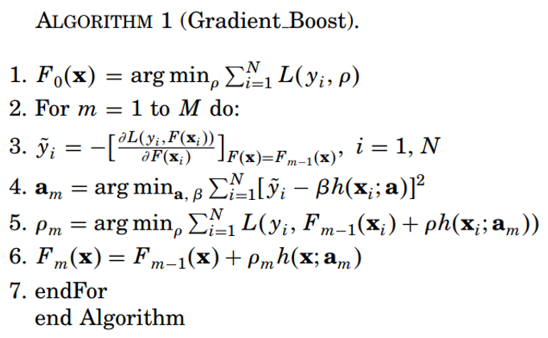
Gradient Descent Boosting

